Slide 1
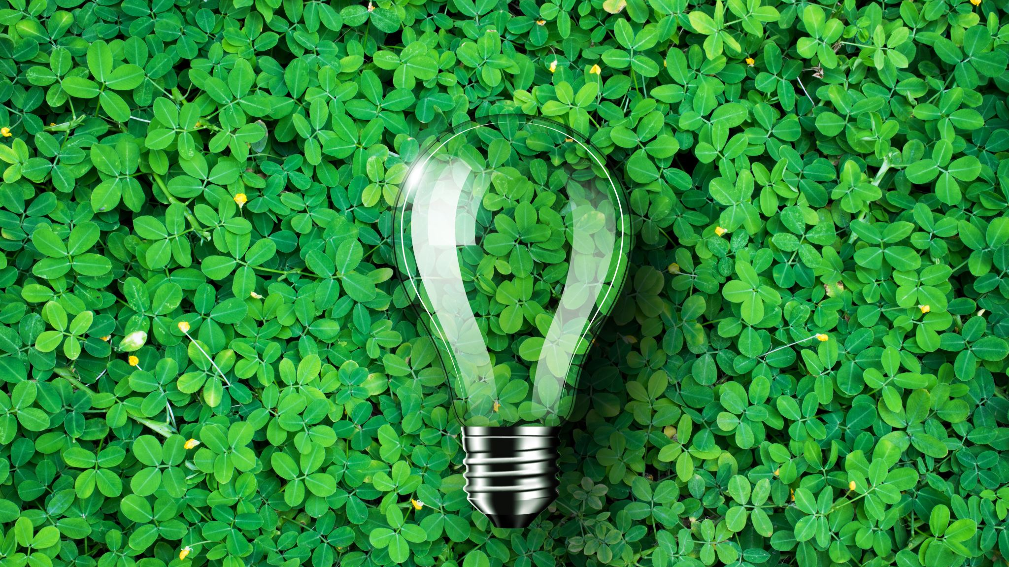

User interface project
The name of our project is Go Green.
The idea.
“Making a website to help people go green by selling healthy meal plans to consumers, that minimizes food waste by informing retailers about customer future purchase “.
By Christopher, Jeffrey and Jeppe

Slide 2
UI design tools and principles
-- > used in our project
Principles
10 usability Heuristics principles ( next slide )
Gestalt principles ( symmetry, similarity, proximity, continuity, focal point ).
--> We choose not to do paper prototyping
( Figma, Marvel pop etc).
Testing
Testing techniques ( UX test – feedback from different users )
--> We choose not to do think aloud testing
Notes:
Gestalt principles:
Symmetry: We coorperated symmetry all over our webpage by placing our element right.
Similarity: We used similarity to relate our different content and elements together
Proximity: Group of things, that clearly belongs, but has seperated features.
Continuity: Same design and functionality all around our webpage
Focal point: Focus on the shopping basket by seperating this in colors

Slide 3
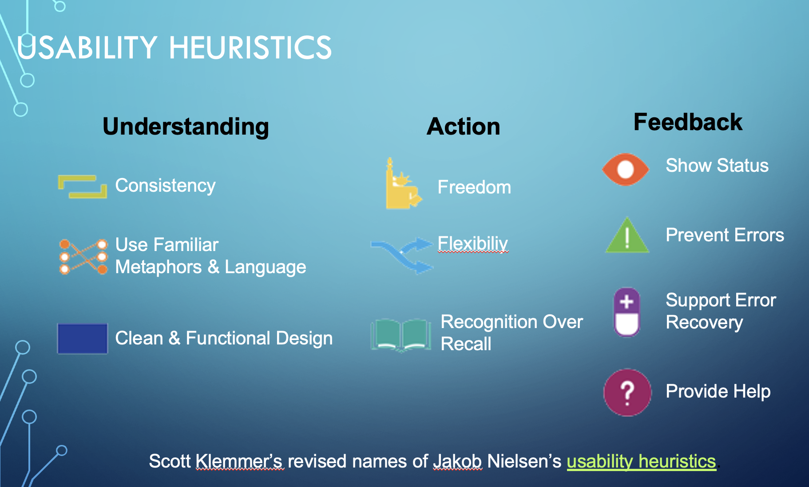
User Interface focus:
Clean & functionel design
Visual appealing
Easy to navigate
Consistency and standards between webpages
Personal experience by login and customized account
Error preventing and security
Notes:
Nielsen and Molich's 10 User Interface Design Guidelines
Link: https://www.interaction-design.org/literature/article/user-interface-design-guidelines-10-rules-of-thumb
CLEAN AND FUNCTIONAL DESIGN: All unnecessary information competes for the user's limited attentional resources, which could inhibit user’s memory retrieval of relevant information. Therefore, the display must be reduced to only the necessary components for the current tasks, whilst providing clearly visible and unambiguous means of navigating to other content.
2. VISUAL APPEALING – same explanation as point 1, but also our customized chooses of really visual appealing pictures all over our webpage.
3. EASY TO NAVIGATE: With increased use comes the demand for less interactions that allow faster navigation. This can be achieved by using abbreviations, function keys, hidden commands and macro facilities. Users should be able to customize or tailor the interface to suit their needs so that frequent actions can be achieved through more convenient means.
Offer users a digital space where backward steps are possible, including undoing and redoing previous actions – this is a key element on our webpage. Its possible to go back and fourth between our webpages and not lose focus, because our different webpage design are very similar.
4. CONSISTENCY AND STANDARDS BETWEEN WEBPAGES: Interface designers should ensure that both the graphic elements and terminology are maintained across similar platforms. For example, an icon that represents one category or concept should not represent a different concept when used on a different screen.
5. NOT SPECIFIC HEURISTICS POINT, but adds overall UX level and takes elements from different HEURISTICS principle.
The point was to create a kind of community, where people could make a profile. Then they would be apple to earn point by how “ Green ” they acted. Some mealplans ( No meat etc. ) would bring them a higher score and this would bring the customer a “ feeling good “ vibe
- ultimately leading us to the goal of hitting a more green world.
6. ERROR PREVENTING AND SECURITY: Whenever possible, design systems so that potential errors are kept to a minimum. Users do not like being called upon to detect and remedy problems, which may on
occasion be beyond their level of expertise. Eliminating or flagging actions that may result in errors are two possible means of achieving error prevention.

Slide 4
The project plan.
Keywords:
Agile
Iterations
Notes:
Agile software development is a term used to describe approaches to software development emphasizing incremental delivery, team collaboration, continual planning, and continual learning, instead of trying to deliver it all at once near the end.
Agile focuses on keeping the process lean and creating minimum viable products (MVPs) that go through a number of iterations before anything is final. Feedback is gathered and implemented continually and in all, it is a much more dynamic process where everyone is working together towards one goal.
Iterative development is a way of breaking down the software development of a large application into smaller chunks. In iterative development, feature code is designed, developed and tested in repeated cycles. With each iteration, additional features can be designed, developed and tested until there is a fully functional software application ready to be deployed to customers.

Slide 5
Analysis
1. Project description – What is the Task?
2. Examination of the project, feasibility study, brainstorming.
3. Customer examination, WH questions, brainstorm, demand analysis.
4. Group meeting, expectations alignment,
brainstorming customer needs.
5. Put ideas on paper.
6. Analysis:
Risk analyse
Interessent analyse,
SWOT analyse,
“ The critical path “ ( which top criterias risk delaying the project).
7. Time schedule for the project.

Slide 6
Planning
Time schedule for iteration
Define goal for this iteration.
Role distribution
Next iteration

Slide 7
Design
UML
Use cases
Domain model
Class diagram
Sequens diagram
UI design ( Gestalt, Heuristics, 10 golden rule of UI )
GRASP

Slide 8
Testing
User testing ( Observing a user and/or extern tester )
Junit testing
Implementation testing
Integration testing
Refactoring ( make adjustments to our code ).

Slide 9
Deploy?

Slide 10
Feedback
Follow up on iteration
Did we reach our goal in this iteration?
Did the tests pass?
Was the process realistic?

Slide 11
Thanks for watching!

Slide 12
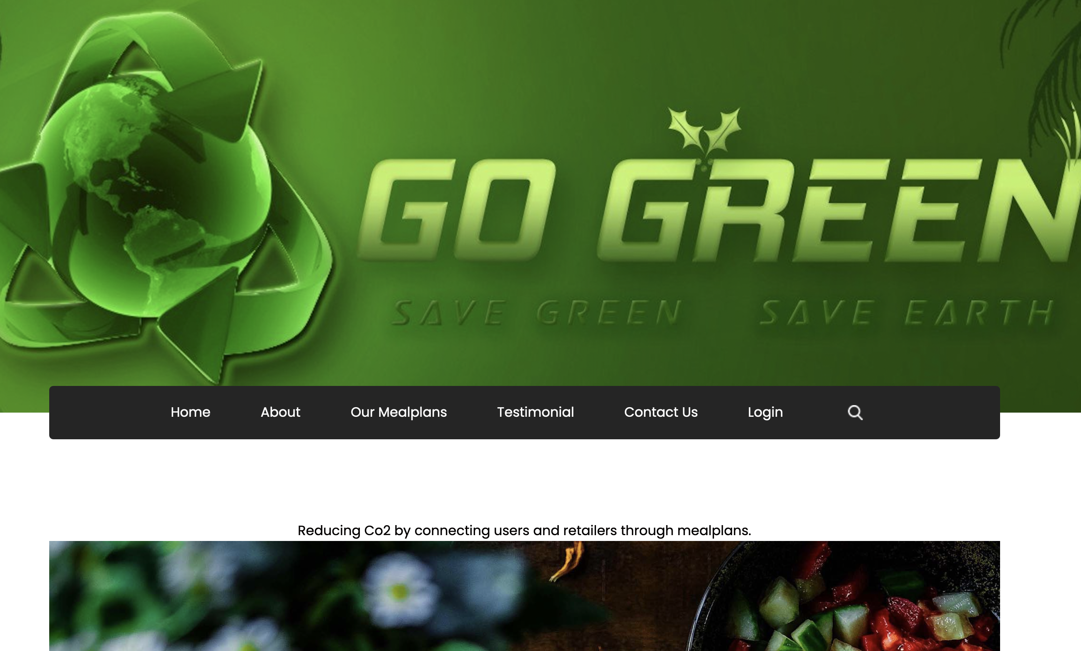
The program - Lets see it!!!
https://gogreener.herokuapp.com/

Slide 13
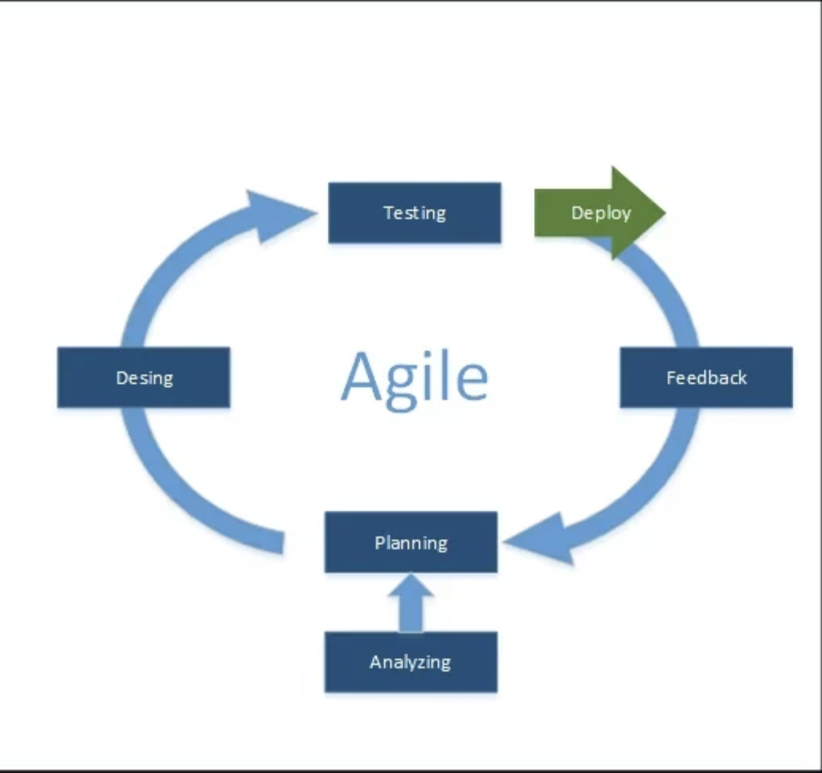
Agile

